Slide 1
Topics to be Covered:
Inheritance
Types of Inheritance
Single Inheritance
Multi-level Inheritance
Hierarchical Inheritance
Multiple Inheritance
Hybrid Inheritance
Method Overriding
Method Overloading Vs Method Overriding
Usage of “super” keyword
Usage of “final” keyword

Slide 2
Inheritance

Slide 3
Inheritance
Inheritance in Java is a mechanism in which one object acquires all the properties and behaviors of a parent object. It is an important part of OOPs (Object Oriented programming system).
The idea behind inheritance in Java is that you can create new classes that are built upon existing classes.
When you inherit from an existing class, you can reuse methods and fields of the parent class. Moreover, you can add new methods and fields to your current class also.
Inheritance represents the IS-A relationship which is also known as a parent-child relationship.
The main advantage of inheritance is “Code Reusability”.

Slide 4
Inheritance:
Terms used in Inheritance:
Class: A class is a group of objects which have common properties. It is a template or blueprint from which objects are created.
Sub Class/Child Class: A subclass is a class that inherits ( or is created from) the other class. It is also called a derived class, extended class, or child class.
Super Class/Parent Class: Superclass is the class from where a subclass inherits the features. It is also called a base class or a parent class.
Reusability: As the name specifies, reusability is a mechanism that facilitates you to reuse the fields and methods of the existing class when you create a new class. You can use the same fields and methods already defined in the previous class.
extends keyword: The extends keyword indicates that you are making a new class that derives from an existing class. The meaning of "extends" is to increase functionality.
Syntax:
class sub_class_name extends super_class_name
{
// methods and fields
}

Slide 5
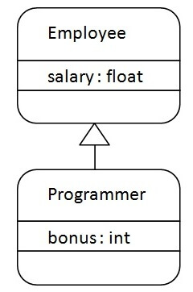
Inheritance : An Example
In the figure, Programmer is the subclass and Employee is the superclass. The relationship between the two classes is Programmer IS-A Employee. It means that Programmer is a type of Employee.
class Employee
{
float salary=40000;
}
class Programmer extends Employee
{
int bonus=10000;
public static void main(String args[])
{
Programmer p=new Programmer();
System.out.println("Programmer salary is:"+p.salary);
System.out.println("Bonus of Programmer is:"+p.bonus);
}
}
Output:
Programmer salary is 40000
Bonus of Programmer is 10000

Slide 6
Types of Inheritance

Slide 7
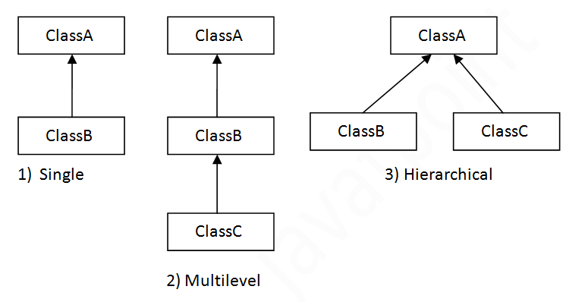
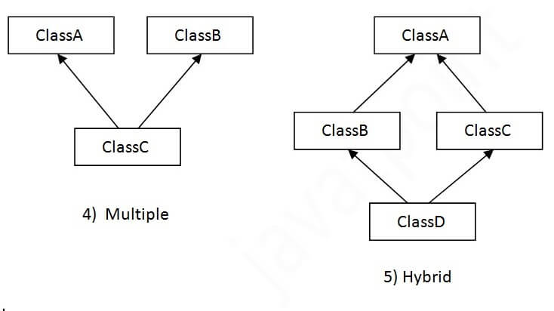
Types of Inheritance
There can be three types of inheritance in java: single, multilevel, and hierarchical.
Note: In java programming, multiple and hybrid inheritance is supported through interface only. We will learn about interfaces later.

Slide 8
Single Inheritance : Example
When a class inherits another class, it is known as a single inheritance. In the example given below, Dog class inherits the Animal class, so there is the single inheritance.
class Animal
{
void eat()
{
System.out.println(“Eating…");
}
}
class Dog extends Animal
{
void bark()
{
System.out.println(“Barking...");
}
}
class TestInheritance
{
public static void main(String args[])
{
Dog d=new Dog();
d.bark();
d.eat();
}
}
Output:
Barking…
Eating…

Slide 9
Multi-level Inheritance : Example
When there is a chain of inheritance, it is known as multilevel inheritance.
As you can see in the example given below, BabyDog class inherits the Dog class which again inherits the Animal class, so there is a multilevel inheritance..
class Animal
{
void eat()
{
System.out.println(“Eating…");
}
}
class Dog extends Animal
{
void bark()
{
System.out.println(“Barking...");
}
}
class BabyDog extends Dog
{
void weep()
{
System.out.println(“Weeping...");
}
}
class TestInheritance
{
public static void main(String args[])
{
BabyDog d=new BabyDog();
d.weep();
d.bark();
d.eat();
}
}
Output:
Weeping…
Barking…
Eating…

Slide 10
Hierarchical Inheritance : Example
When two or more classes inherit a single class, it is known as hierarchical inheritance.
In the example given below, Dog and Cat classes inherit the Animal class, so there is hierarchical inheritance.
class Animal
{
void eat()
{
System.out.println(“Eating…");
}
}
class Dog extends Animal
{
void bark()
{
System.out.println(“Barking...");
}
}
class Cat extends Animal
{
void meow()
{
System.out.println(“Meowing...");
}
}
class TestInheritance
{
public static void main(String args[])
{
Cat c=new Cat();
c.meow();
c.eat();
//c.bark(); will raise error
}
}
Output:
Meowing…
Eating…

Slide 11
Method Overriding

Slide 12
Method Overriding
If subclass (child class) has the same method as declared in the parent class, it is known as method overriding in Java.
In other words, If a subclass provides the specific implementation of the method that has been declared by one of its parent class, it is known as method overriding.
Usage of Java Method Overriding
Method overriding is used to provide the specific implementation of a method wthatis already provided by its superclass.
Method overriding is used for runtime polymorphism
Rules for Java Method Overriding
The method must have the same name as in the parent class
The method must have the same parameter as in the parent class.
There must be an IS-A relationship (inheritance).

Slide 13

Method Overriding: Example
Understanding the problem without method overriding
Let's understand the problem that we may face in the program if we don't use method overriding.
//Here, we are calling the method of parent class with child class object.
class Vehicle
{
void run()
{
System.out.println("Vehicle is running");
}
}
//Creating a child class
class Bike extends Vehicle
{
public static void main(String args[])
{
//creating an instance of child class
Bike obj = new Bike();
//calling the method with child class instance
obj.run();
}
}
Problem is that We have to provide a specific implementation of run() method in subclass that is why we use method overriding.
Output:
Vehicle is running

Slide 14

Method Overriding: Example
In this example, we have defined the run method in the subclass as defined in the parent class but it has some specific implementation. The name and parameter of the method are the same, and there is IS-A relationship between the classes, so there is method overriding.
//Creating a parent class.
class Vehicle
{
void run()
{
System.out.println("Vehicle is running");
}
}
//Creating a child class
class Bike2 extends Vehicle
{
//defining the same method as in the parent class
void run()
{
System.out.println("Bike is running safely");
}
public static void main(String args[])
{
//creating an instance of child class
Bike2 obj = new Bike2();
//calling the child class method
obj.run();
}
}
Output:
Bike is running safely

Slide 15
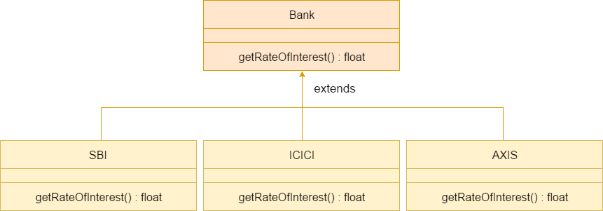

Method Overriding: A real example
Consider a scenario where Bank is a class that provides functionality to get the rate of interest. However, the rate of interest varies according to banks.
For example, SBI, ICICI and AXIS banks could provide 8%, 7%, and 9% rate of interest.

Slide 16

Method Overriding: A real example
Consider a scenario where Bank is a class that provides functionality to get the rate of interest. However, the rate of interest varies according to banks.
For example, SBI, ICICI and AXIS banks could provide 8%, 7%, and 9% rate of interest.
class Bank
{
int getRateOfInterest()
{
return 0;
}
}
//Creating child classes.
class SBI extends Bank
{
int getRateOfInterest()
{
return 8;
}
}
class ICICI extends Bank
{
int getRateOfInterest()
{
return 7;
}
}
class AXIS extends Bank
{
int getRateOfInterest()
{
return 9;
}
}

Slide 17

Method Overriding: A real example
class Test2
{
public static void main(String args[])
{
SBI s=new SBI();
ICICI i=new ICICI();
AXIS a=new AXIS();
System.out.println("SBI Rate of Interest: "+s.getRateOfInterest());
System.out.println("ICICI Rate of Interest: "+i.getRateOfInterest());
System.out.println("AXIS Rate of Interest: "+a.getRateOfInterest());
}
}
Output:
SBI Rate of Interest: 8
ICICI Rate of Interest: 7
AXIS Rate of Interest: 9

Slide 18
Method Overloading Vs Method Overriding
Method Overloading | Method Overriding
Method overloading is used to increase the readability of the program. | Method overriding is used to provide the specific implementation of the method that is already provided by its super class.
Method overloading is performed within class. | Method overriding occurs in two classes that have IS-A (inheritance) relationship.
In case of method overloading, parameters must be different. | In case of method overriding, parameter must be same.
Method overloading is an example of compile time polymorphism. | Method overriding is the example of run time polymorphism.
In java, method overloading can't be performed by changing return type of the method only. | Return type must be same in method overriding.

Slide 19
super keyword

Slide 20
super keyword
The super keyword in Java is a reference variable that is used to refer to an immediate parent class object.
Whenever you create the instance of a subclass, an instance of the parent class is created implicitly which is referred by a super reference variable.
Usage of Java super Keyword
Super can be used to refer immediate parent class instance variable.
Super can be used to invoke the immediate parent class method.
super() can be used to invoke the immediate parent class constructor.

Slide 21

super keyword
1) super is used to refer immediate parent class instance variable.
We can use super keyword to access the data member or field of the parent class. It is used if parent class and child class have the same fields.
class Animal
{
String color="white";
}
class Dog extends Animal
{
String color="black";
void printColor()
{
//prints color of Dog class
System.out.println(color);
//prints color of Animal class
System.out.println(super.color);
}
}
class TestSuper1
{
public static void main(String args[])
{
Dog d=new Dog();
d.printColor();
}
}
In the above example, Animal and Dog both classes have a common property color. If we print color property, it will print the color of current class by default. To access the parent property, we need to use super keyword.
Output:
black
white

Slide 22
super keyword
2) super can be used to invoke parent class method
The super keyword can also be used to invoke parent class method. It should be used if subclass contains the same method as parent class. In other words, it is used if method is overridden.
class Animal
{
void eat()
{
System.out.println("eating...");
}
}
class Dog extends Animal
{
void eat()
{ System.out.println("eating bread...");
}
void bark()
{
System.out.println("barking...");
}
void work()
{
super.eat();
bark();
}
}
class TestSuper2
{
public static void main(String args[])
{
Dog d=new Dog();
d.work();
}
}
Output:
eating…
barking…

Slide 23
super keyword
3) super is used to invoke parent class constructor.
The super keyword can also be used to invoke the parent class constructor.
class Animal
{
Animal()
{
System.out.println(“Animal is created");
}
}
class Dog extends Animal
{
Dog()
{
super();
System.out.println(“Dog is created");
}
}
class TestSuper3
{
public static void main(String args[])
{
Dog d=new Dog();
}
}
Output:
Animal is created
Dog is created
Note: super() is added in each class constructor automatically by compiler if there is no super() or this().

Slide 24
super keyword
Another example of super keyword where super() is provided by the compiler implicitly.
class Animal
{
Animal()
{
System.out.println(“Animal is created");
}
}
class Dog extends Animal
{
Dog()
{
System.out.println(“Dog is created");
}
}
class TestSuper4
{
public static void main(String args[])
{
Dog d=new Dog();
}
}
Output:
Animal is created
Dog is created
Note: super() is added in each class constructor automatically by compiler if there is no super() or this().

Slide 25
super() : An Example
Here, Emp class inherits Person class so all the properties of Person will be inherited to Emp by default.
To initialize all the property, we are using parent class constructor from child class. In such way, we are reusing the parent class constructor.
class Person
{
int id;
String name;
Person(int id,String name)
{
this.id=id; this.name=name;
}
}
class Emp extends Person
{
float salary;
Emp(int id,String name,float salary)
{
super(id,name);//reusing parent constructor
this.salary=salary;
}
void display()
{
System.out.println(id+" "+name+" "+salary);
}
}
class TestSuper5
{
public static void main(String[] args)
{
Emp e1=new Emp(1,“Ajay",45000f);
e1.display();
}
}
Output:
1 Ajay 45000

Slide 26
final keyword

Slide 27
final keyword
The final keyword in java is used to restrict the user. The java final keyword can be used in many context. Final can be:
variable
method
Class
1) Java final variable : If you make any variable as final, you cannot change the value of final variable(It will be constant)
class Bike
{
final int speedlimit=90;//final variable
void run()
{
speedlimit=400;
}
public static void main(String args[])
{
Bike obj=new Bike();
obj.run();
}
}
There is a final variable speedlimit, we are going to change the value of this variable, but It can't be changed because final variable once assigned a value can never be changed.
Output:
Compile time error

Slide 28
final keyword
2) Java final method: If you make any method as final, you cannot override it.
class Bike
{
final void run() //final method
{
System.out.println("running");
}
}
class Honda extends Bike
{
void run()
{
System.out.println("running safely with 100kmph");
}
public static void main(String args[])
{
Honda honda= new Honda();
honda.run();
}
}
Here, run() method is declared as final. Hence, it cannot be overridden in sub-class.
Output:
Compile time error

Slide 29
final keyword
3) Java final class : If you make any class as final, you cannot extend it.
final class Bike
{
}
class Honda extends Bike
{
void run()
{
System.out.println("running safely with 100kmph");
}
public static void main(String args[])
{
Honda honda= new Honda();
honda.run();
}
}
Here, Bike class is declared as final class. Hence, sub-class cannot be created from it.
Output:
Compile time error

Slide 30
Thank you

